Slide 1



National University | 2026
WEBPROG Finals Presentation

Slide 2
LokAlert: A Landing Page
Members:
Alemana, Onyx
Billones, Gerald
Crisologo, Tj
Mabahin, Ryan
Royo, Aenard

Slide 3
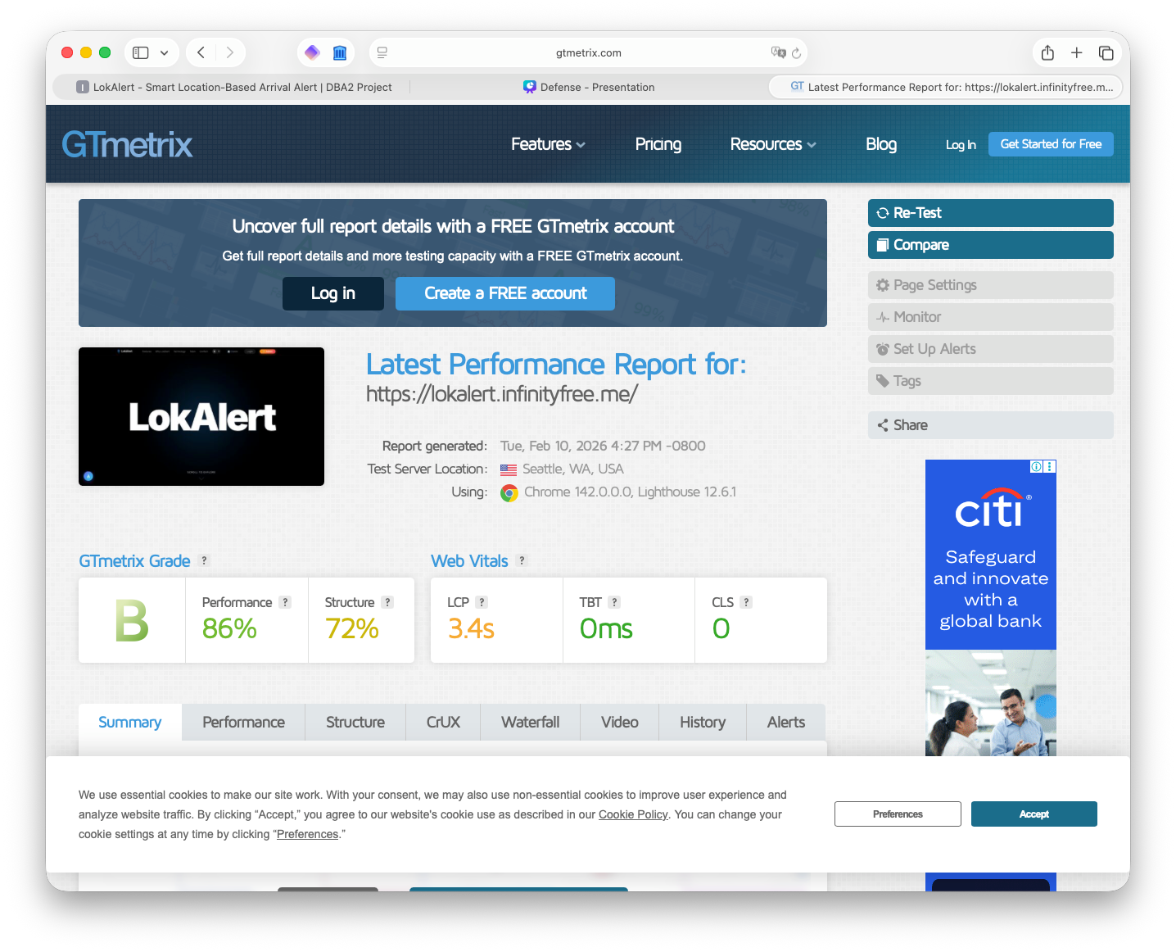

Slide 4
THE WEBSITE STRUCTURE
Home Page (index.php)
- Hero Section (dynamic stats from database)
- How It Works
- Features (8 feature cards)
- Why LokAlert (4 reasons)
- Technology Stack
- Meet the Team
- Contact CTA
- Footer
Contact Page (contact.php)
- Contact Form (Name, Email, Subject, Message)
- Server-side validation + database INSERT
Admin Panel (admin.php)
- Login Page (session-based authentication)
- Dashboard (after login)
- Stats Overview (Downloads, Users, Versions, Messages)
- APK Versions Tab (Create, Read, Update, Delete)
- Users Tab (Create, Read, Update, Delete)
- Messages Tab (Read, Mark as Read, Delete)
- Download Logs Tab (Read)

Slide 5
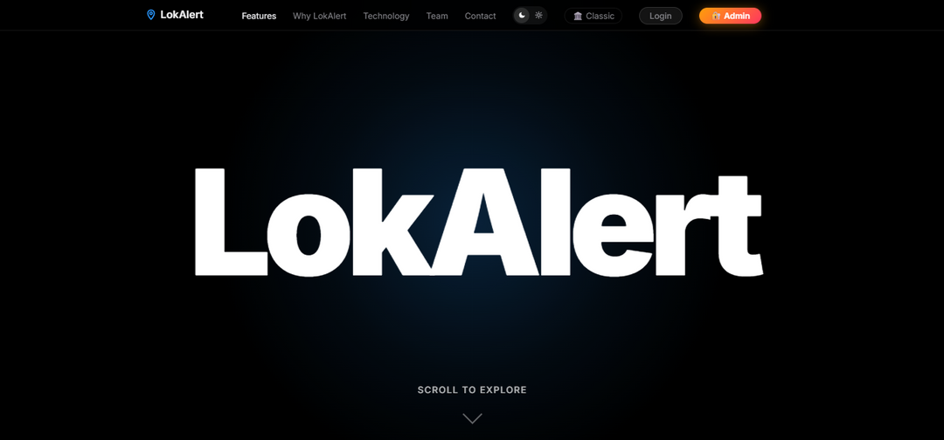
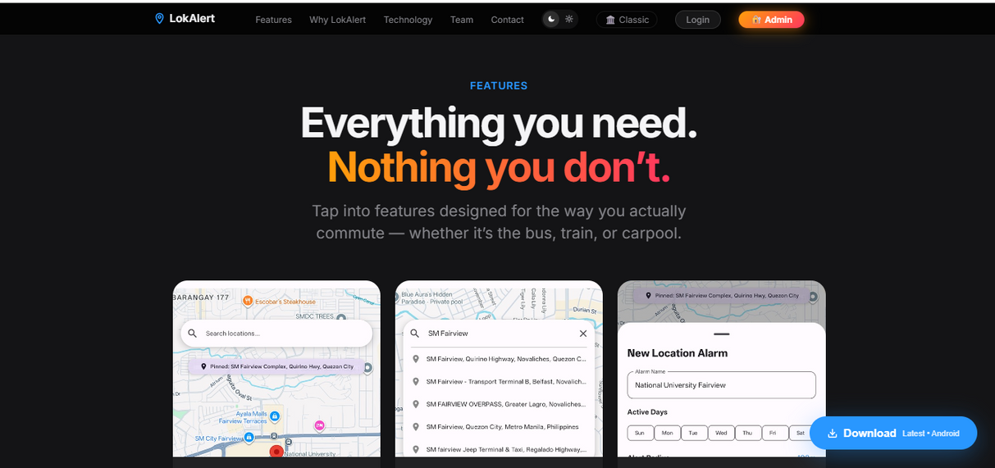
VISUAL DESIGN
Home Page
Shows the fixed top navbar with menu links: Features, Why LokAlert, Technology, Team, Admin
Features
Show the 8 feature cards grid: Location Search, Map View, Set Arrival Radius, Start Location Tracking, Arrival Alert/Alarm, Background Monitoring, Saved Locations, Cancel Tracking

Slide 6
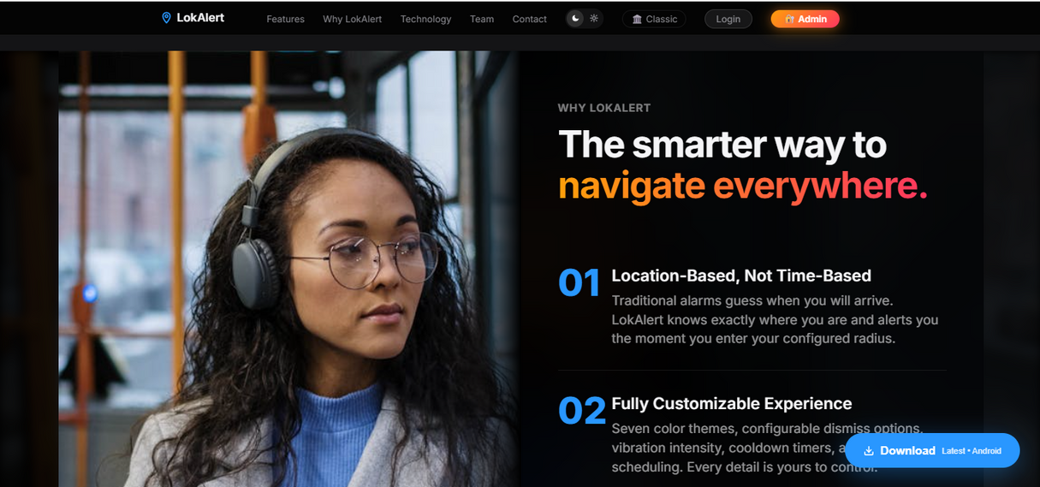
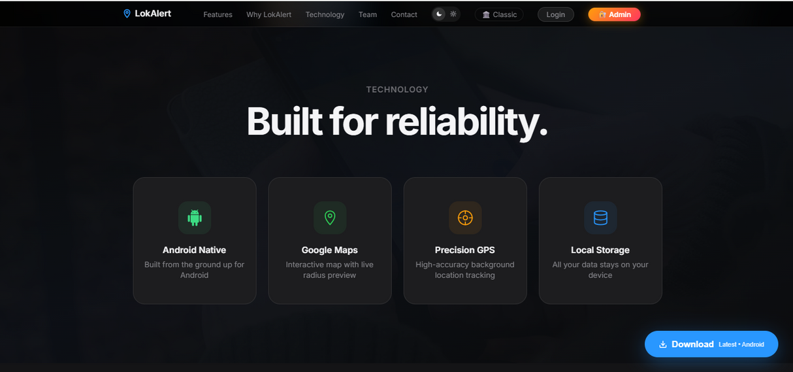
VISUAL DESIGN
Why LokAlert
Shows the application’s selling points.
Technology
Showcases the technologies used to power the application.

Slide 7
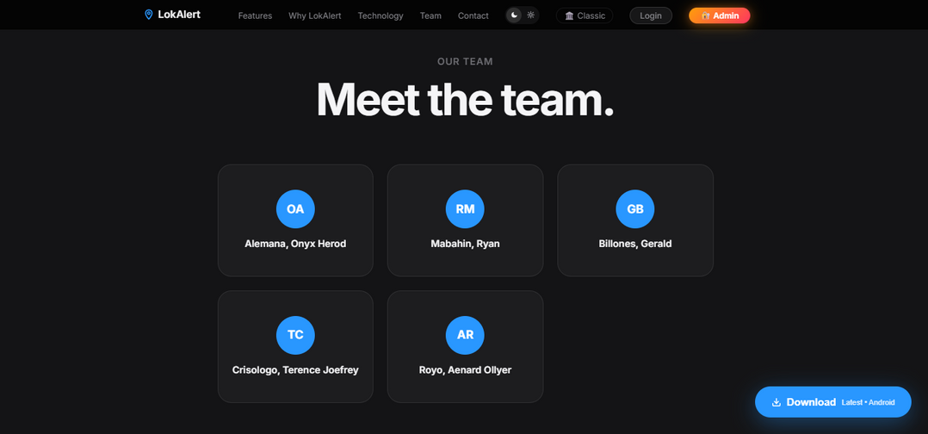
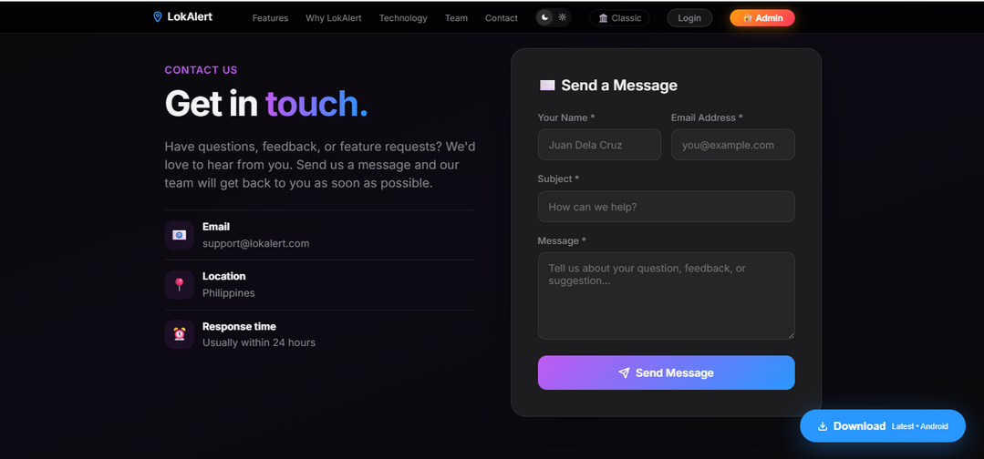
VISUAL DESIGN
Team
Shows the team members.
Contact
Contact us Form

Slide 8
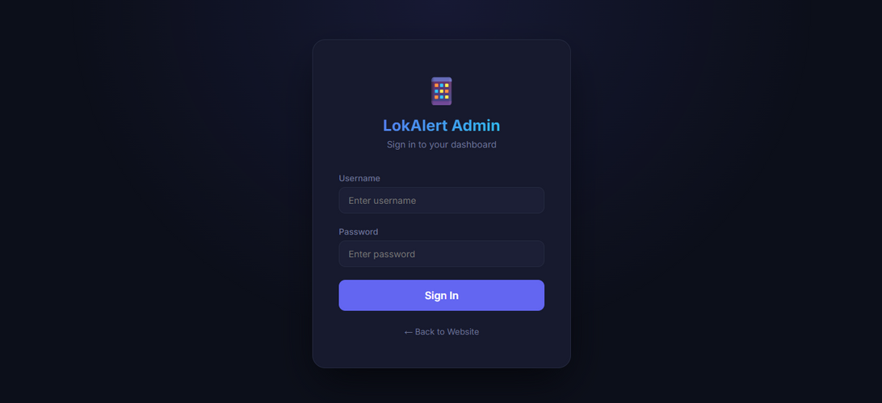
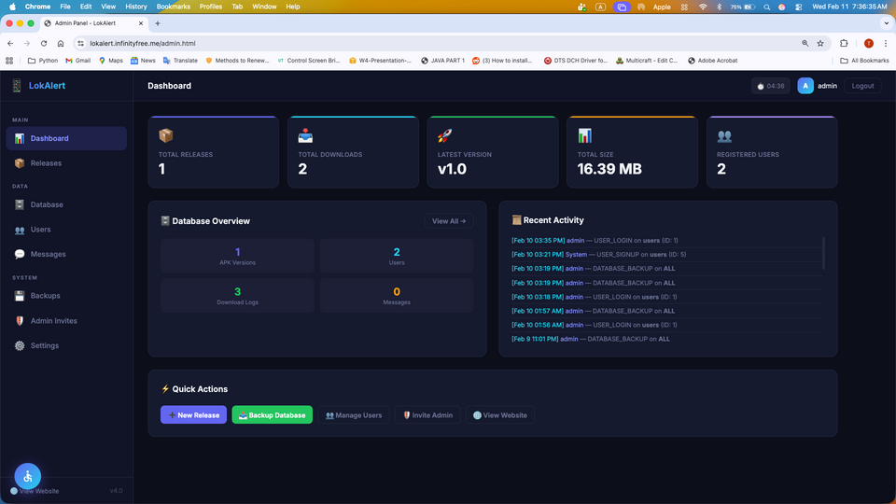
VISUAL DESIGN
Admin Login Page
Admin Dashboard

Slide 9
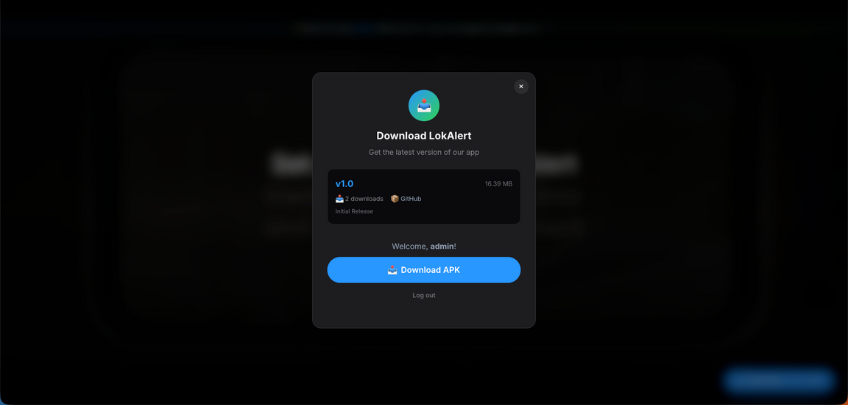
VISUAL DESIGN
Download Popup
Admin Dashboard

Slide 10
BUILD THE WEBSITE
PLATFORM USED
  HTML
  CSS
  JavaScript
  PHP
  MySQL

Slide 11
TOOLS AND
RESOURCES
DEVELOPMENT TOOLS
DESIGN TOOLS
  VS Code
  XAMPP
  GitHub
  Git
  phpMyAdmin
  Figma
  Canva
HOSTING AND DEPLOYMENT
  InfinityFree
  GitHub Releases
  Gmail SMTP
TESTING TOOLS
  GTmetrix

Slide 12
THANK YOU

